Slide 1

CodeAlpha Task
Phishing Awareness Training

Slide 2
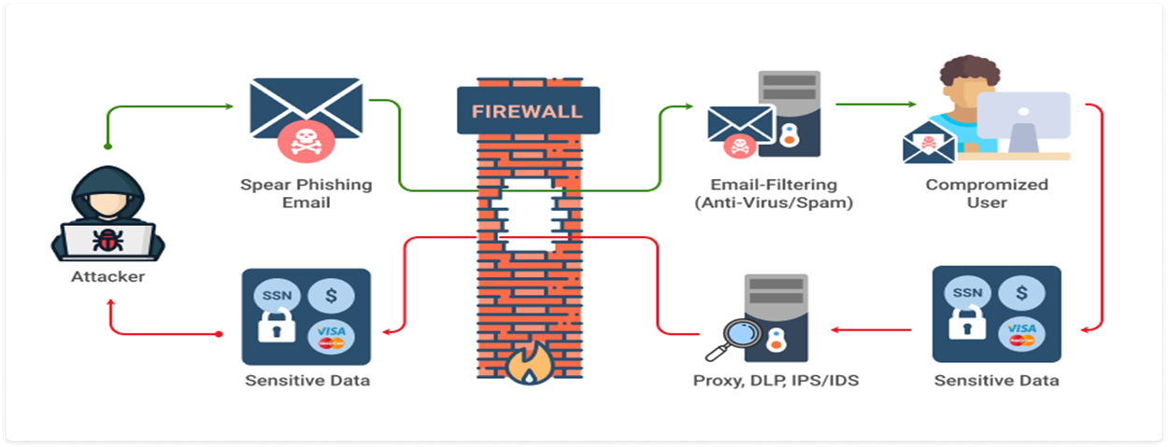

Slide 3
Introduction to Phishing
Phishing is a type of cyber attack where attackers attempt to trick individuals into revealing sensitive information such as usernames, passwords, or financial details. It often involves deceptive emails, websites, or messages designed to appear legitimate.

Slide 4
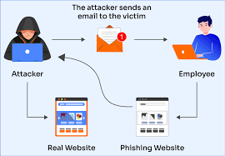

Slide 5
Objectives of This Training
Understand what phishing is and how it works.
Identify common signs of phishing emails and websites.
Learn best practices to avoid falling victim to phishing attacks.
Know how to report phishing attempts effectively.

Slide 6
Types of Phishing Attacks
Email Phishing:
Fake emails that appear to come from trusted sources.
Examples: "Your account is compromised, click here to reset your password."
Spear Phishing:
Targeted attacks on specific individuals or organizations.
Often includes personal information to appear credible.
Clone Phishing:
Duplicates of legitimate emails with malicious links or attachments.
Voice Phishing (Vishing):
Phone calls pretending to be from banks or companies asking for sensitive data.
SMS Phishing (Smishing):
Fraudulent text messages with malicious links.

Slide 7
Recognizing Phishing Attempts
Red Flags in Emails:
Suspicious sender addresses (e.g., mismatched domains).
Generic greetings (e.g., "Dear Customer").
Urgent or alarming language (e.g., "Act now or your account will be locked!").
Spelling and grammar errors.
Suspicious Links:
Hover over links to check the actual URL.
Look for misspellings or unusual domains (e.g., "paypal-secure-login.com").
Attachments:
Be cautious with unexpected attachments, especially executable files (e.g., .exe, .zip).

Slide 8
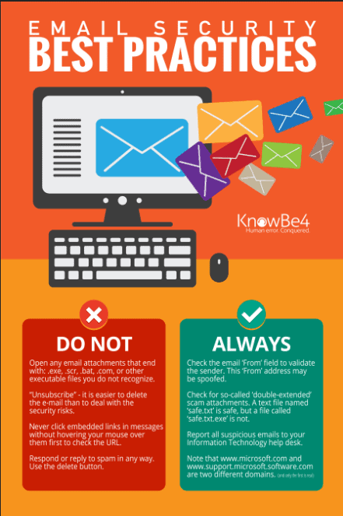
Best Practices to Avoid Phishing
Verify Sender Identity:
Contact the organization directly using official contact information.
Check URLs Carefully:
Ensure websites start with "https://" and the domain matches the official site.
Enable Multi-Factor Authentication (MFA):
Adds an extra layer of security even if credentials are compromised.
Use Security Tools:
Install email filters and antivirus software to block malicious content.
Stay Informed:
Regularly update yourself on the latest phishing tactics.

Slide 9
What to Do If You Suspect a Phishing Attempt
Do not click links or open attachments.
Report the email to your IT department or service provider.
Delete the email after reporting.
Monitor your accounts for unauthorized activity.

Slide 10
Interactive Quiz
Question 1:
Which of the following is a common sign of a phishing email?
A. Grammatical errors
B. A legitimate company email address
C. Personalized greeting
Correct Answer: A. Grammatical errors
Question 2:
What should you do if you receive a suspicious email?
A. Click the link to verify
B. Report it to IT
C. Delete it immediately
Correct Answer: B. Report it to IT

Slide 11
Conclusion
Phishing attacks can be highly deceptive, but awareness and vigilance are key to staying protected. Always double-check suspicious messages and follow your organization’s reporting procedures.

